Slide 1
ASP.NET Core & EF Core INTRO, FEATURES & HIGHLIGHTS
Halil İbrahim Kalkan

Slide 2
Agenda
About Me & My Projects
.Net Standard vs .Net Core vs .Net Framework
ASP.NET Core, Overall
ASP.NET Core, MVC
Entity Framework Core
Demo: Integration Testing
Final Words & Decisions

Slide 3


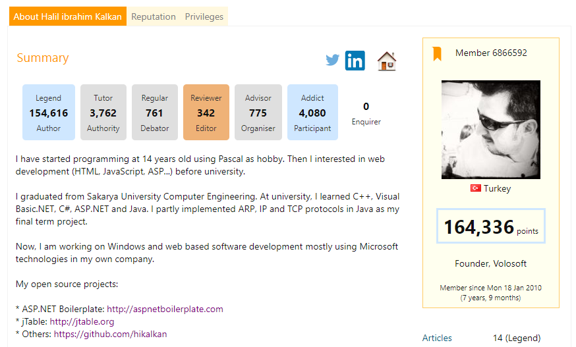
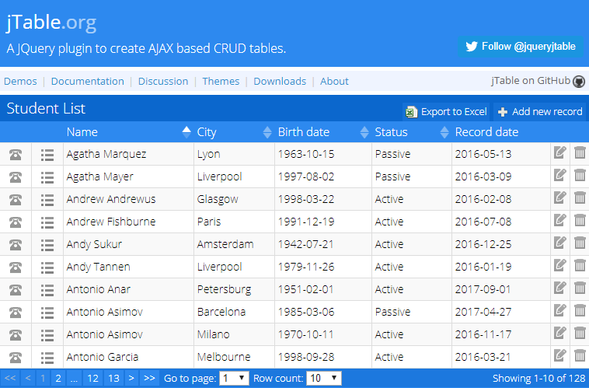

About Me & My Projects
https://github.com/hikalkan
https://www.codeproject.com/members/hi_kalkan
http://jtable.org/

Slide 4

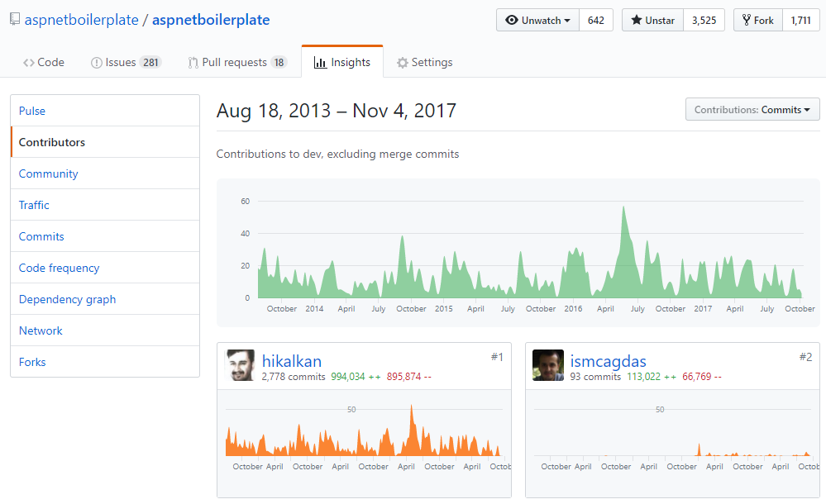
https://aspnetboilerplate.com
Layered & Modular Architecture
Multi Tenancy / SaaS
Domain Driven Design

Slide 5
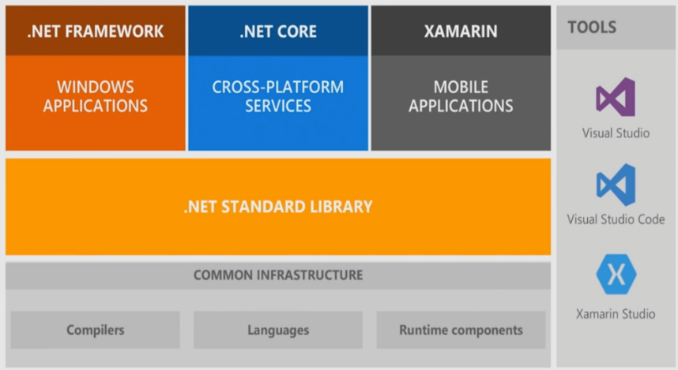
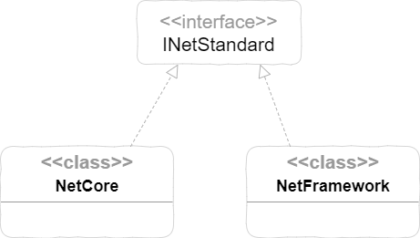
.Net Standard vs .Net Core vs .Net Framework

Slide 6
Microsoft.Extensions.* Libraries
Independent from ASP.NET Core!
Dependency Injection (and 3rd-party adapters)
Castle Windsor: https://github.com/volosoft/castle-windsor-ms-adapter
Configuration (appsettings.json and more)
Logging
Caching
Localization
…

Slide 7
ASP.NET Core
Modern, Lightweight, Componentized Architecture
High-performance, Microservice-Focused!
Unified Web Stack (MVC UI + Web API)
Extensible
Testable

Slide 8
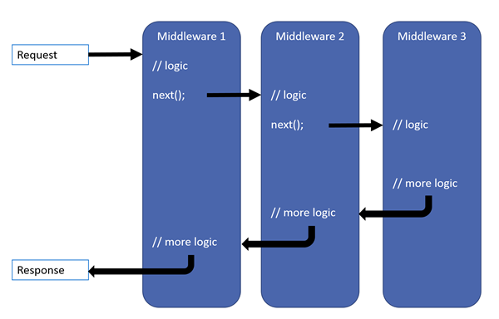
ASP.NET Core Middleware Pipeline
Common Middlewares
Authentication
Request Localization
Exception Page
Static Files
MVC

Slide 9
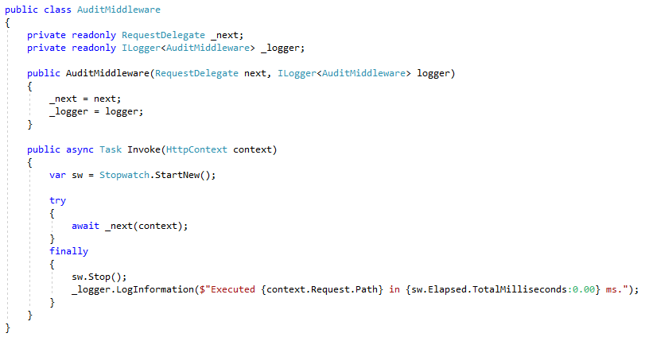
ASP.NET Core Simple Middleware

Slide 10
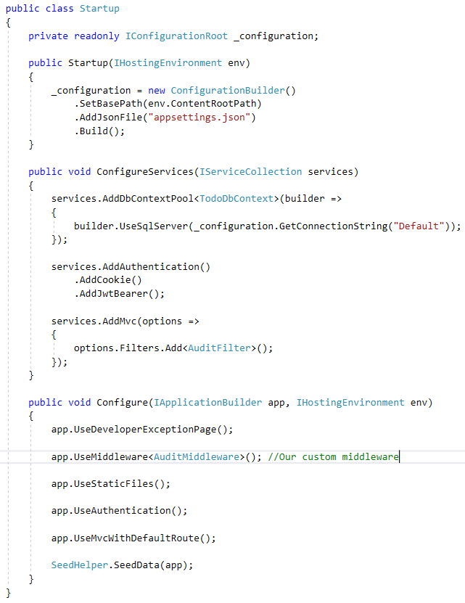
ASP.NET Core Startup Class
Register dependencies and configure options
Add middlewares (by order)
Initialize the application

Slide 11
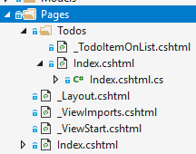
ASP.NET Core MVC Razor Pages
No more MVC!
Razor Pages -> UI (recommended & default)
Controllers (without View) -> (REST) API
New Pages folder (and folder hierarchy)
Supports all razor features

Slide 12
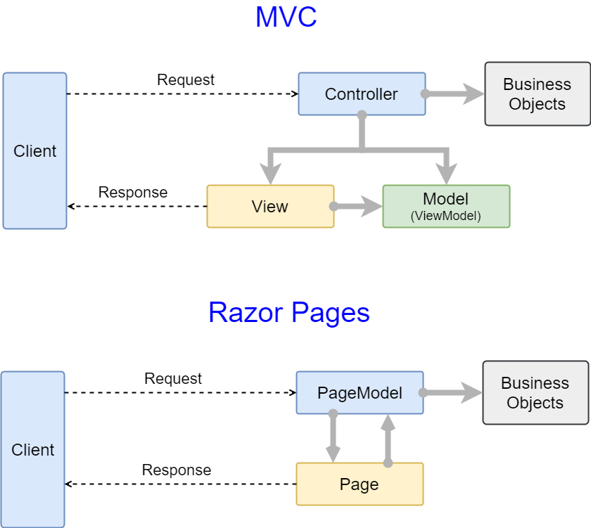
ASP.NET Core MVC Razor Pages

Slide 13
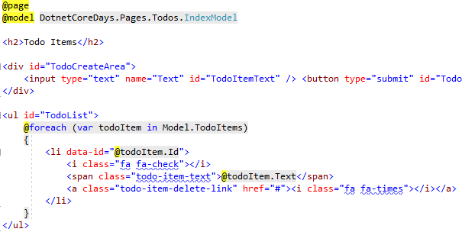
ASP.NET Core MVC Razor Pages > Page (View)
New @page directive

Slide 14
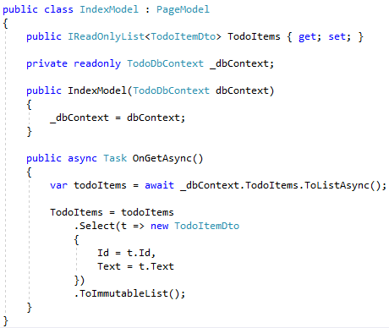
ASP.NET Core MVC Razor Pages
Inherit PageModel (or declare [PageModel])
OnGetAsync -> HTTP GET
OnPostAsync -> HTTP POST
Public properties/methods are accessible from razor page (UI)

Slide 15
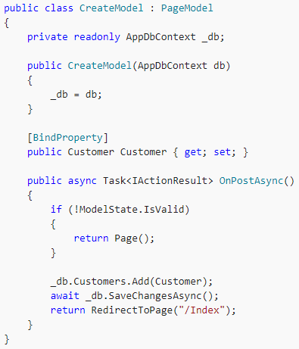
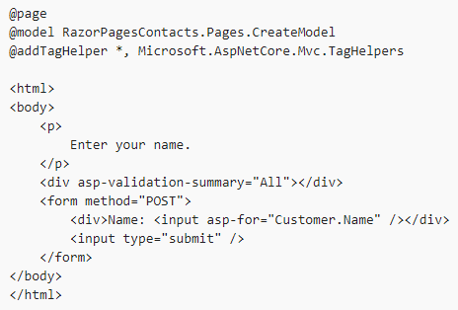
ASP.NET Core MVC Razor Pages > BindProperty

Slide 16
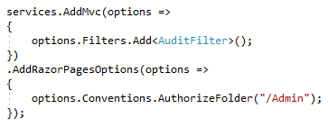
ASP.NET Core MVC Razor Pages > Other Features
Authorization
Missing features
Does not support Action Filters yet (planned for v2.1)
Does not handle Partial Views well

Slide 17
ASP.NET Core MVC Other v2.0 Changes
New Microsoft.AspNetCore.All package
Automatic page & view compilation on publish (default)
Unified Authentication Middleware
TempData (share data between requests! Uses Cookie by default)

Slide 18

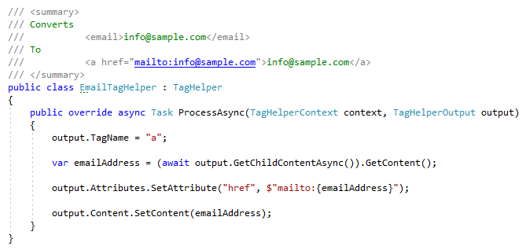
ASP.NET Core MVC Tag Helpers
Define new tags, attributes
Manipulate rendering of HTML elements
Remove elements from output conditionally
Add surrounding/inner elements

Slide 19
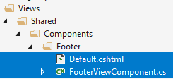
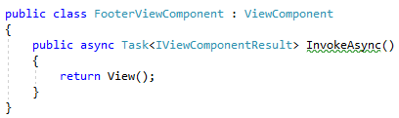

ASP.NET Core MVC View Components
Child Actions removed
Introduced View Components
Similar to partial views with it’s own action
Can be used like tag helpers (with vc: prefix) or with Component.Invoke method

Slide 20
ASP.NET Core MVC Client Side Development
Client-side package management..?
Npm or Bower (deprecated)
Bundling, Minification..?
Bundler & Minifier Visual Studio Extension
Web Compiler Visual Studio Extension
Gulp/Grunt

Slide 21
Entity Framework Core
Developed from scratch, optimized for cloud!
Compared to EF 6.x
Lightweight, better performance
Cleaner SQL output
Better testability (supports in-memory database out of the box)
Missing features
Lazy load (instead, use explicit load)
Database first (probably will never support)
Seed data
TPT & TPC inheritance
Lifecycle hooks/events

Slide 22
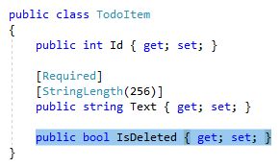
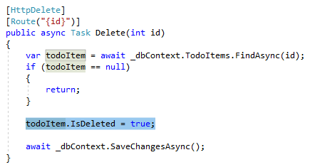
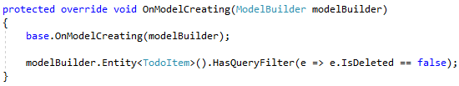
Entity Framework Core Global Query Filters
Common use cases:
Soft-delete / Active-passive entities
Multi-tenancy
Missing features / limitations
Does not support multiple filter expressions (need to combine multiple filters in a single expression)
Filters can only be defined on the root Entity Type of a hierarchy

Slide 23

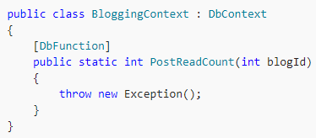

Entity Framework Core Other v2.0 features
DbContext Pooling
Database scalar function mapping
Others
Table Splitting (multiple entities share same table)
Owned types (can be used for complex types)
Explicitly compiled queries (little performance improvement)

Slide 24
DEMO - Integration Testing
Using the following tools:
ASP.NET Core as web framework
Entity Framework Core as ORM
with SQLite in-memory database
xUnit as test framework
Shoudly as assertion library
AngleSharp as HTML parser
Source code: https://github.com/hikalkan/presentations

Slide 25



Final Words & Decisions
ASP.NET Core MVC or ASP.NET MVC 5.x..?
.net core or .net framework..?
Entity Framework Core or Entity Framework 6.x..?
Multi-Page Application or Single-Page Application..?
Server-Rendered HTML or Client-Rendered HTML..!
halilibrahimkalkan.com
hikalkan
hibrahimkalkan

